Slide 1
Artificial Intelligence
in Digital Marketing

Slide 2
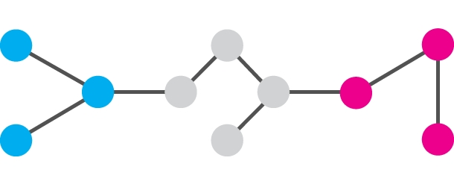
What is Artificial Intelligence?
Artiﬁcial intelligence is about making computers able to perform the thinking tasks that humans and animals are capable of.

Slide 3
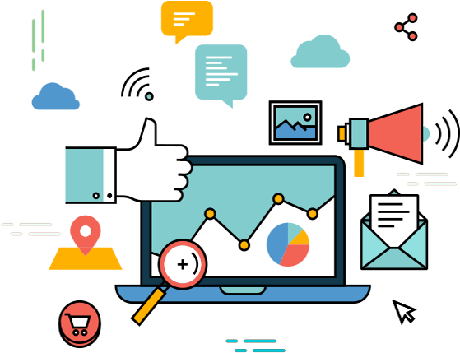
What is Digital Marketing?
Digital marketing is the marketing and advertising of a business, person, product, or service using online channels, electronic devices, and digital technologies.

Slide 4
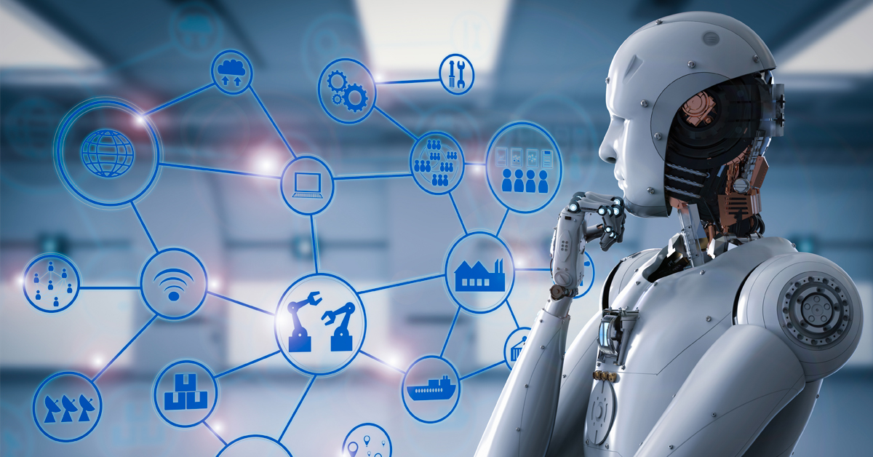
Artificial Intelligence & Digital Marketing

Slide 5


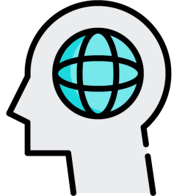



Benefits of Artificial Intelligence in Digital Marketing
Automation
Minimizing Errors
Cost Savings
Smarter Decision Making
Increased ROI
Increased Personalization

Slide 6
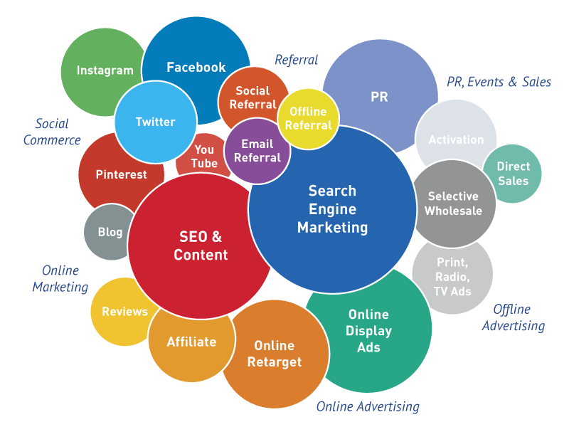
Applications of Artificial Intelligence in Digital Marketing

Slide 7

USER EXPERIENCE (UX)

Slide 8
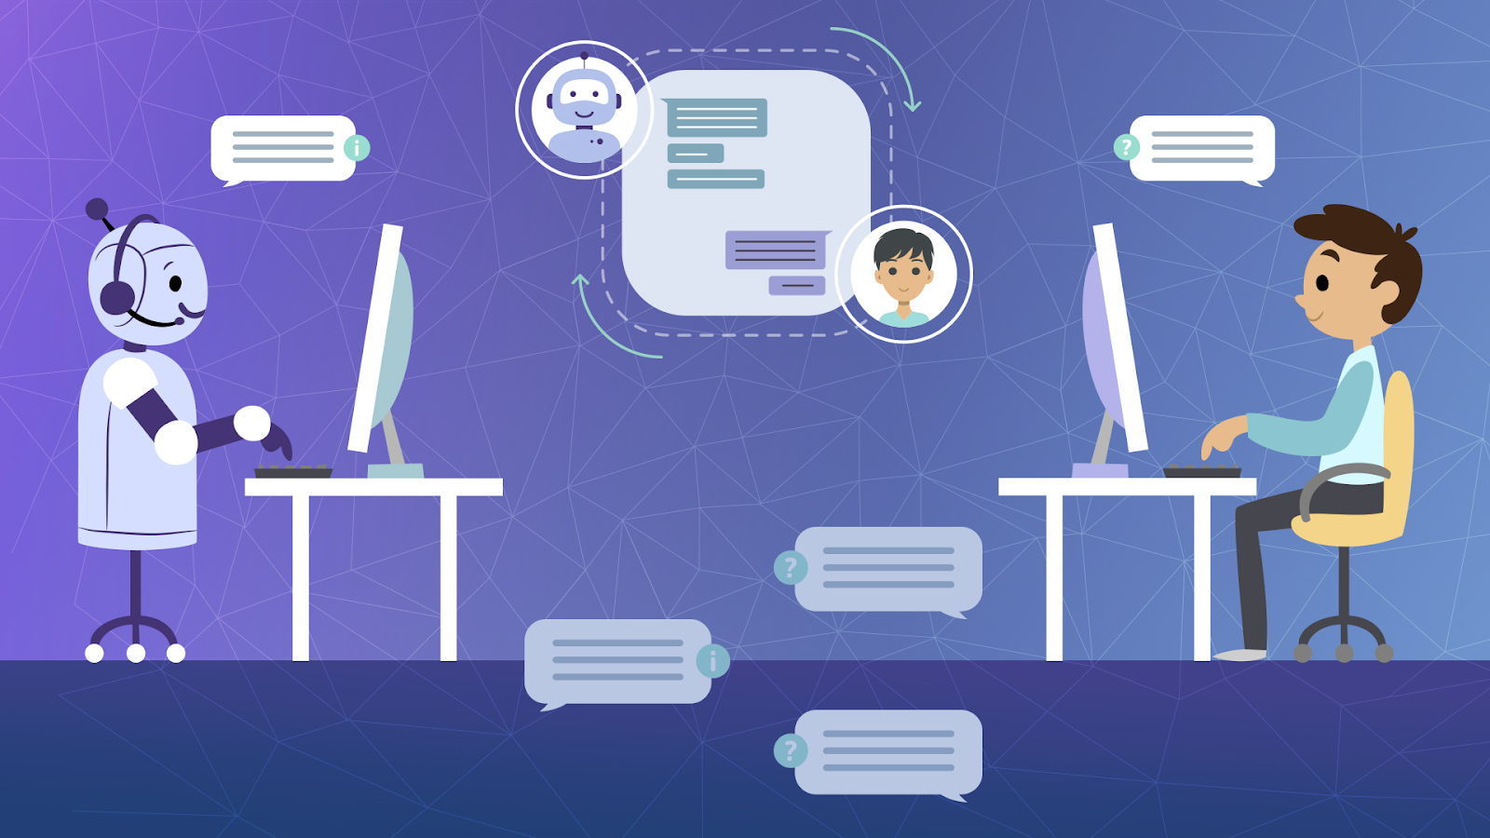
CHATBOTS

Slide 9
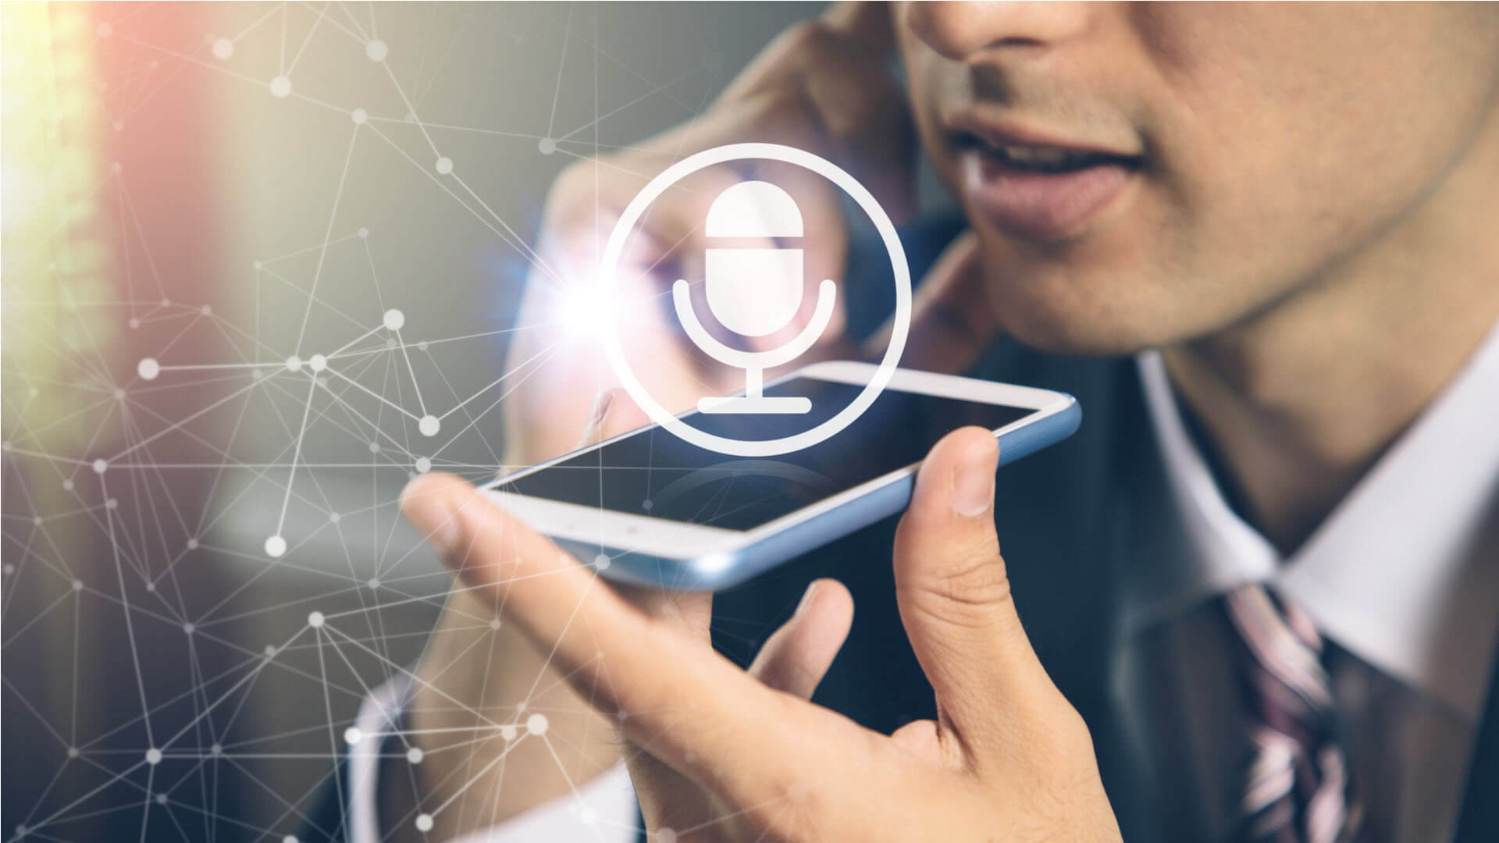
VOICE SEARCH OPTIMIZATION

Slide 10

WEB DESIGNING

Slide 11
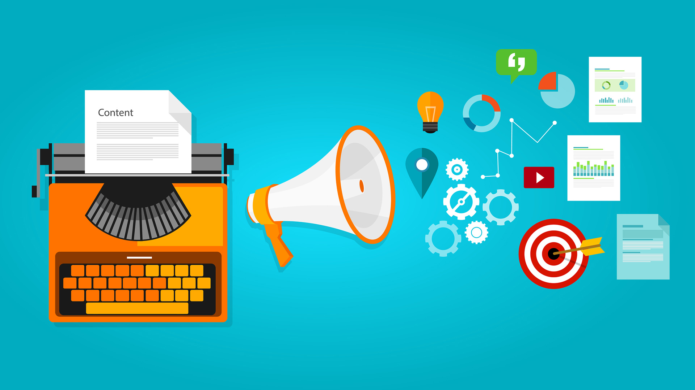
DIGITAL ADVERTISING

Slide 12

CONCLUSION
Technological advancements have always helped businesses by creating new opportunities for reaching customers. One of greatest technologies of our time is Artificial Intelligence (AI) which is creating great opportunities for digital marketers to grow their business. Now It’s up to you to implement this technology in your business. But one thing for sure is that AI is the future. If you plan on running a successful online business in the coming years, using AI-powered tools is a must.

